Slide 1


HIV Program Supply Chain Management
Logistics Ordering Tool
14 December 2015
Port Moresby, Papua New Guinea

Slide 2
INTRODUCTION
SCM Logistics Ordering Tool
InSTEDD ( Innovative Support To Emergencies, Disasters & Diseases)
Created on April 2012, under MoU between CHAI and InSTEDD
Logistics Management Information System (LMIS) on site ordering process

Slide 3
PURPOSE
Time
Shorter Turn Around Time: Less than 7 days
Faster submission of orders
Faster approval from Logistics Unit
Accuracy
All users have the same value, same template
Better tracking of orders, minimize loss of orders
Ease of Submission: Online

Slide 4
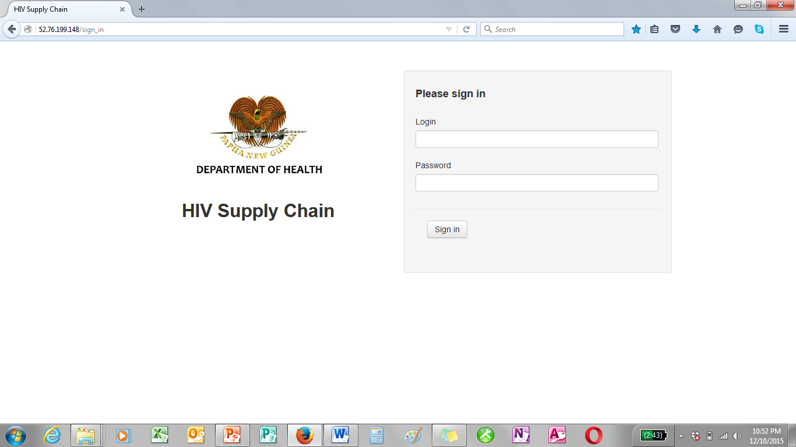
FEATURES
Open source application
Need Internet connection
Computers
Dongle, Wifi
Internet Plans
Site: http://52.76.199.148
Accessible 24 hours
Cloud server

Slide 5


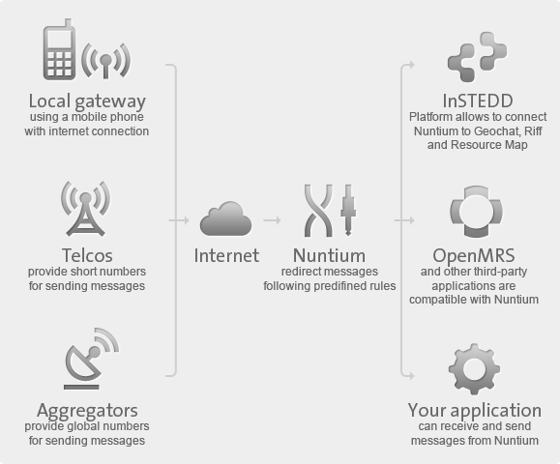
FEATURES
SMS through Local Gateway- Nuntium
System automatically send SMS
Advise sites on orders dispatch
Number of cartons
MSIV/Connote Numbers
Date of Dispatch
Site feedback
Fully received
Partially received
Lost
SMS reminders sent on approved frequency
Site reply closes the transaction as complete
Local Gateway

Slide 6

FEATURES
System
Automated Predefined Rules
Site
Local Gateway
+67573473601
Manual Reply
SMS DELIVERY

Slide 7
FEATURES
Users
Admin: Logistics Unit
Site: Clinic, Pathologic Laboratories, Hospitals
Data Entry: Logistics Unit
Data Entry-Reviewer: Logistics Unit
AMS: Logistics Unit

Slide 8
GENERAL PROCEDURE
Site logs in, create order and upload
Sends Surv forms through email, fax or courier
Informs Logistics Unit of uploaded orders
Logistics officer review and approves order
AMS to fill order
AMS to dispatch order
AMS inform sites through SMS dispatch information
Site replies through SMS receipt of order

Slide 9
PROCEDURE-ADMIN
Admin
Set up all required information
Users
Commodities; Drugs & Kits
Holiday Settings
SMS Settings
Set up local gateway
Set up all phone numbers for SMS on orders dispatch and site feedback
Do changes on information as needed

Slide 10

PROCEDURE-SITE
Site
1. Type
Username
(Site Name)
&
Password
( Nominated)
2. Sign in

Slide 11
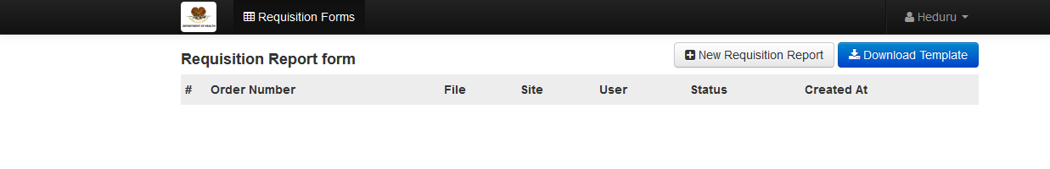
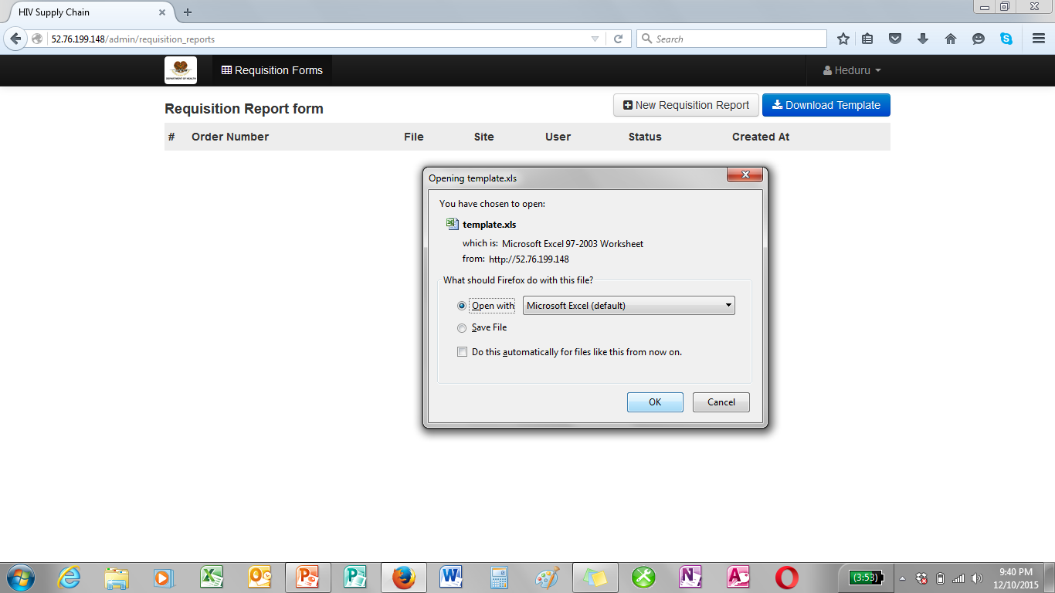
PROCEDURE-SITE
3. Click
Download template
4. Open With Excel
5. Press OK

Slide 12
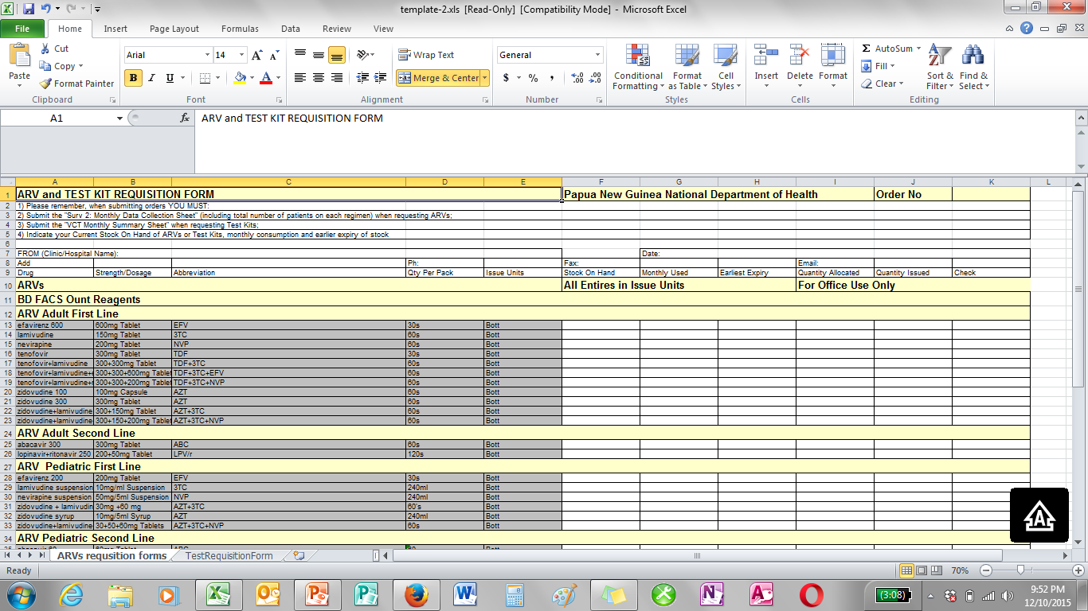
PROCEDURE-SITE
6. Fill Order Forms
Templates\Order Template Drug & Test Kits.xls
Templates\Order Template HIV Test Kits and Lab Commodities.xls
Templates\Heduru Order 09 Dec 2015.xls

Slide 13
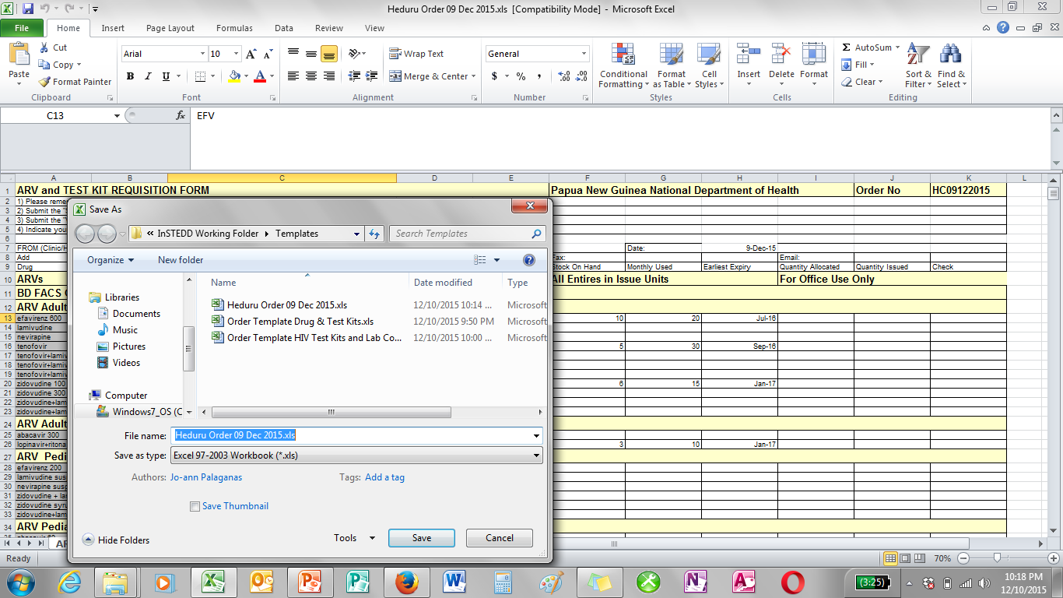
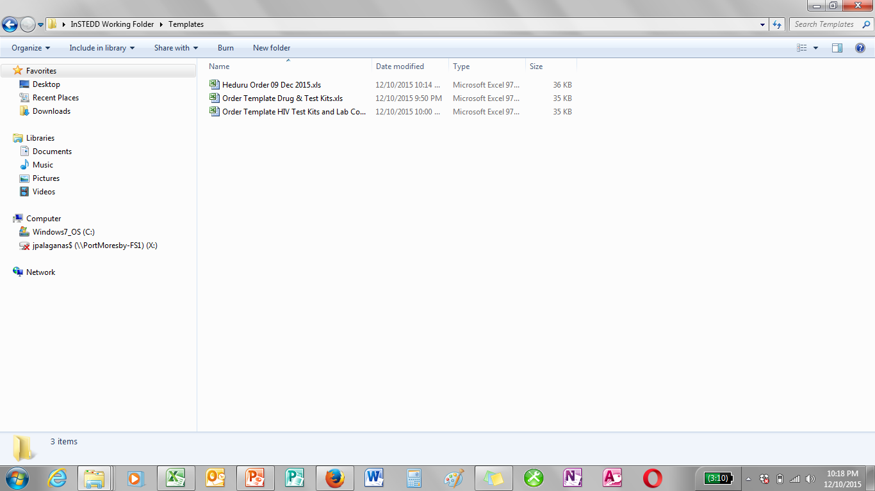
PROCEDURE-SITE
7. Save orders in your computer

Slide 14
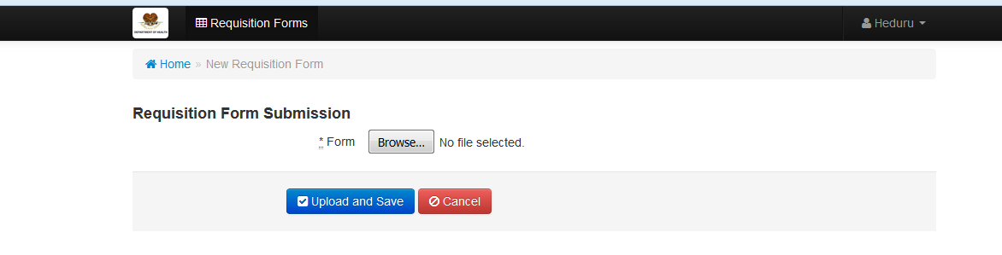
PROCEDURE-SITE
8. New Requisition Report
9. Browse file from location where you saved

Slide 15
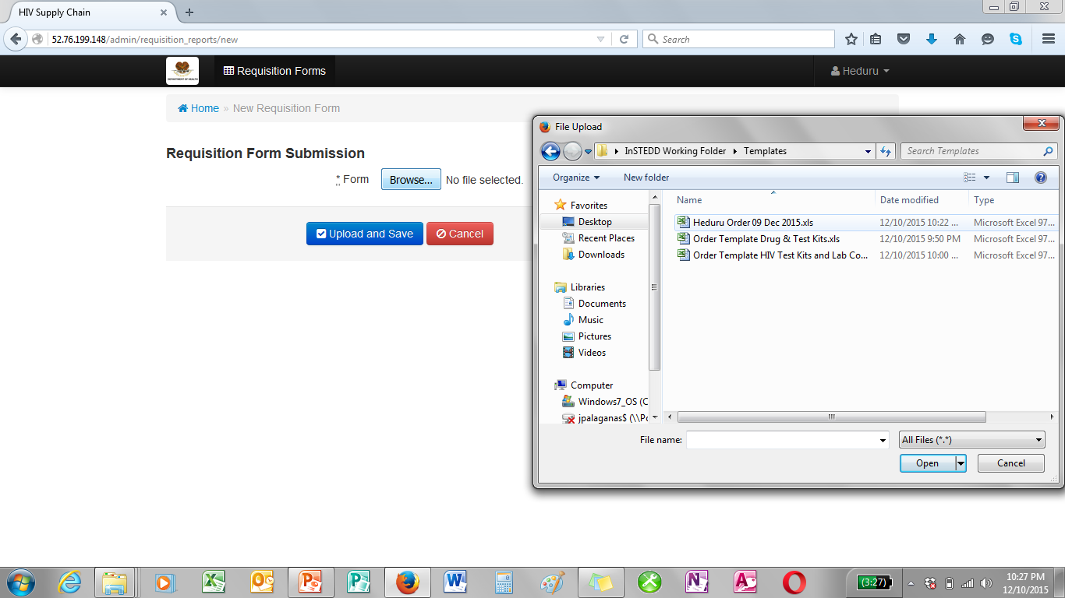
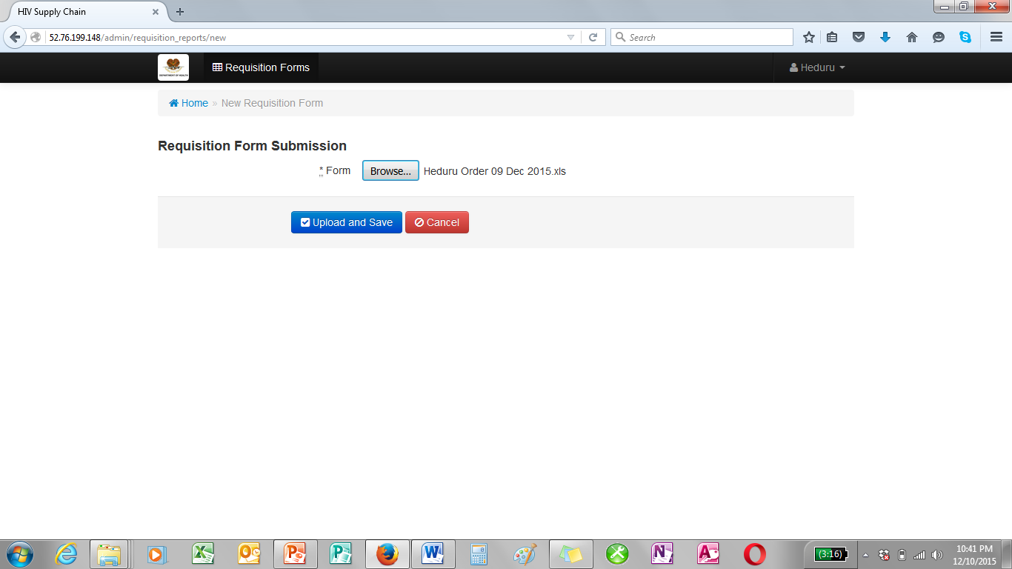
PROCEDURE-SITE
10. Attach file
11. Upload and save

Slide 16
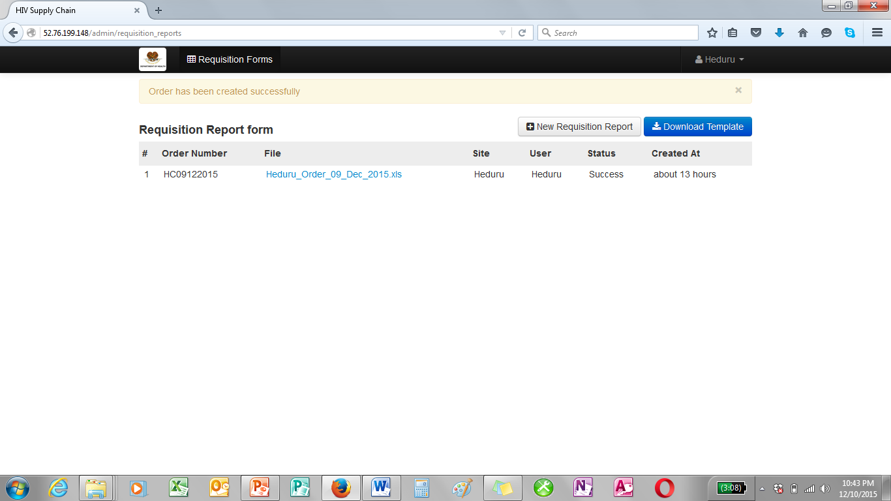
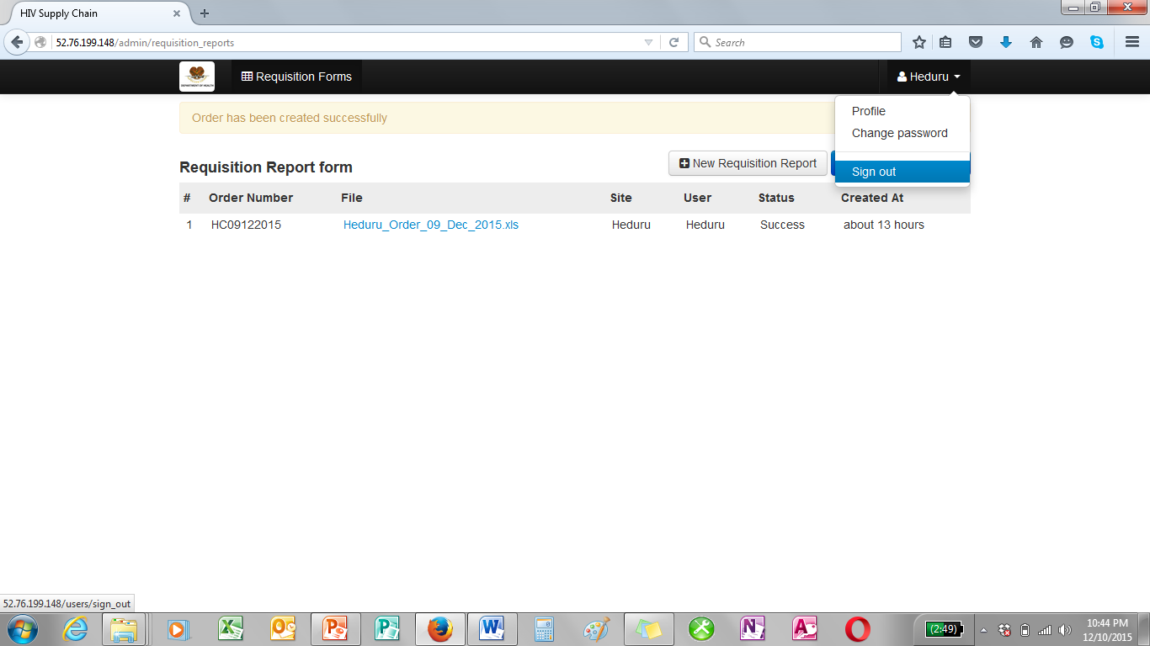
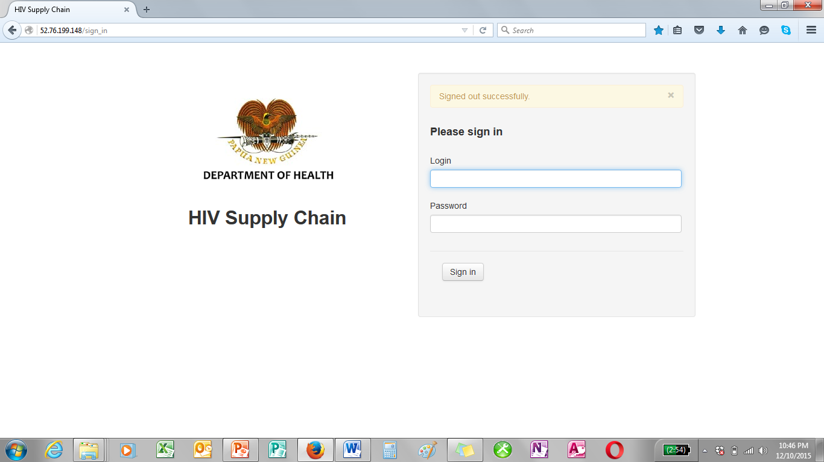
PROCEDURE-SITE
12. Order has been created successfully
13. Sign out

Slide 17
PROCEDURE - SMS
System-Site
Shipment Details
Connote No - Date Dispatched - No of cartons-Order No
Feedback Reminder
Reminds Site to give feedback on dispatched orders
Order Reminder
Reminds Site to give feedback on dispatched orders

Slide 18
PROCEDURE - SMS
Site-System
Received Orders:
y/yes/received/r- Number of cartons
Orders Not Received
l/lost/no/n-Number of cartons
Partially Received Order
p/partial-Number of cartons

Slide 19
PROCEDURE-DATA REVIEWER
Receive order from sites
Review orders
Approve quantities
Submit orders for AMS to process

Slide 20
PROCEDURE-AMS
Download orders
Print orders
Attach MDS cover pages
Get MSIV Number
Prepare the orders
Create Shipment & Dispatch to LD
Send SMS to sites on dispatched orders

Slide 21
EXERCISES
Hands On!

Slide 22
QUESTIONS?

Slide 23


